Slide 1
Android data & files

Slide 2
Table of contents
Data and file storage overview
App-specific storage
Preferences
Databases

Slide 3
Data and file storage overview
Android uses a file system that's similar to disk-based file systems
The system provides several options save your app data:
App-specific storage: Store files or information that other apps shouldn't access
Shared storage: files to share with other apps
Preferences: Store private, primitive data in key-value pairs
Databases: Store structured data

Slide 4
 | Type of content | Access method | Permissions needed | Can other apps access? | Files removed on app uninstall?
App-specific files | Files meant for your app's use only | internal storage: getFilesDir() getCacheDir() external storage: getExternalFilesDir() getExternalCacheDir() | Never needed | No | Yes
Media | Shareable media files (images, audio files, videos) | MediaStore API | Needed depends on API level | Yes | No
Documents and other files | shareable content, including downloaded files | Storage Access Framework | None | Yes, through the system file picker | No
App preferences | Key-value pairs | Jetpack Preferences library | None | No | Yes
Database | Structured data | Room persistence library | None | No | Yes

Slide 5
Access app-specific files
Ref Page: https://developer.android.google.cn/training/data-storage/app-specific
The system provides the following locations for storing such app-specific files:
Internal storage directories: storing persistent files, and cache data. The system prevents other apps from accessing these locations, these locations are encrypted.
External storage directories: Although it's possible for another app to access these directories if that app has the proper permissions, the files stored in these directories are meant for use only by your app.
What are the main differences between Internal storage and External storage?

Slide 6
Read Part Access persistent files
What kind of permissions does it need to access files in internal storage directories?
What should be considered before writing app-specific files to internal storage?
Try to explain next code snippet
String filename = "myfile"; String fileContents = "Hello world!"; try (FileOutputStream fos = context.openFileOutput(filename, Context.MODE_PRIVATE)) { fos.write(fileContents.toByteArray()); }

Slide 7
File path in the device
Read Page 271
Where to find the output files?

Slide 8
Read cache files related Parts
When to used cache files?
What are differences between cache files and persistent files?
How can getCacheQuotaBytes() help in using cache files?

Slide 9
Read Part Access from external storage
Give some examples of external storage device
The most important thing before using external storage?

Slide 10
Save key-value data
https://developer.android.google.cn/training/data-storage/shared-preferences
If you have a relatively small collection of key-values that you'd like to save, you should use the SharedPreferences APIs.
SharedPreferences file can be private?
Is it the same as Preference APIs?

Slide 11
Read Get a handle to shared preferences
When to use getSharedPreferences()?
When to use getPreferences()?
How to name your shared preference files?

Slide 12
Write to shared preferences
To write to a shared preferences file, create a SharedPreferences.Editor by calling edit() on your SharedPreferences.
Explain the code briefly
When to use commit()? Why?
SharedPreferences sharedPref = getActivity().getPreferences(Context.MODE_PRIVATE); SharedPreferences.Editor editor = sharedPref.edit(); editor.putInt(getString(R.string.saved_high_score_key), newHighScore); editor.apply();

Slide 13
Read from shared preferences
To retrieve values from a shared preferences file, call methods such as getInt() and getString(), providing the key for the value you want, and optionally a default value to return if the key isn't present.
Explain the code snippet
SharedPreferences sharedPref = getActivity().getPreferences(Context.MODE_PRIVATE); int defaultValue = getResources().getInteger(R.integer.saved_high_score_default_key); int highScore = sharedPref.getInt(getString(R.string.saved_high_score_key), defaultValue);

Slide 14
File path in the device
Read Page 269
Where to find the shared-preferences files?

Slide 15
Local database
SQLite
Save data using SQLite
Save data in a local database using Room

Slide 16

SQLite
SQLite is a C-language library that implements a small, fast, self-contained, high-reliability, full-featured, SQL database engine.
SQLite is the most used database engine in the world.
The SQLite file format is stable, cross-platform, and backwards compatible and the developers pledge to keep it that way through at least the year 2050.

Slide 17
Save data using SQLite
Read Page 278
What are operations of SQLite can we do?
To use SQLiteOpenHelper, Which callbacks to be overridesd in creating a subclass?
When to use getWritableDatabase() or getReadableDatabase()? Give brief reasons.

Slide 18
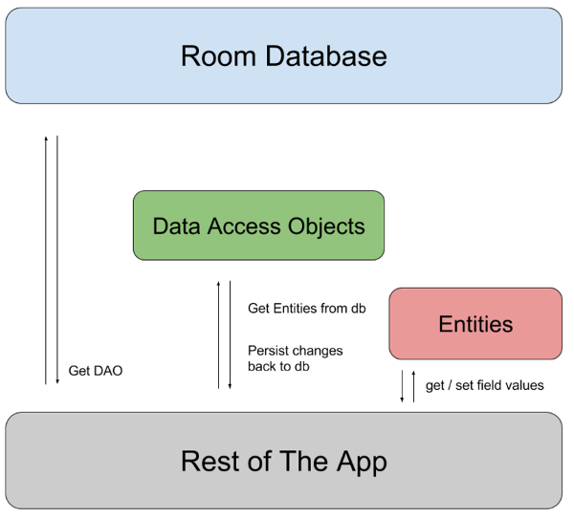
Save data in a local database using Room
Ref site: https://developer.android.google.cn/training/data-storage/room
What are 3 major components in Room?

Slide 19
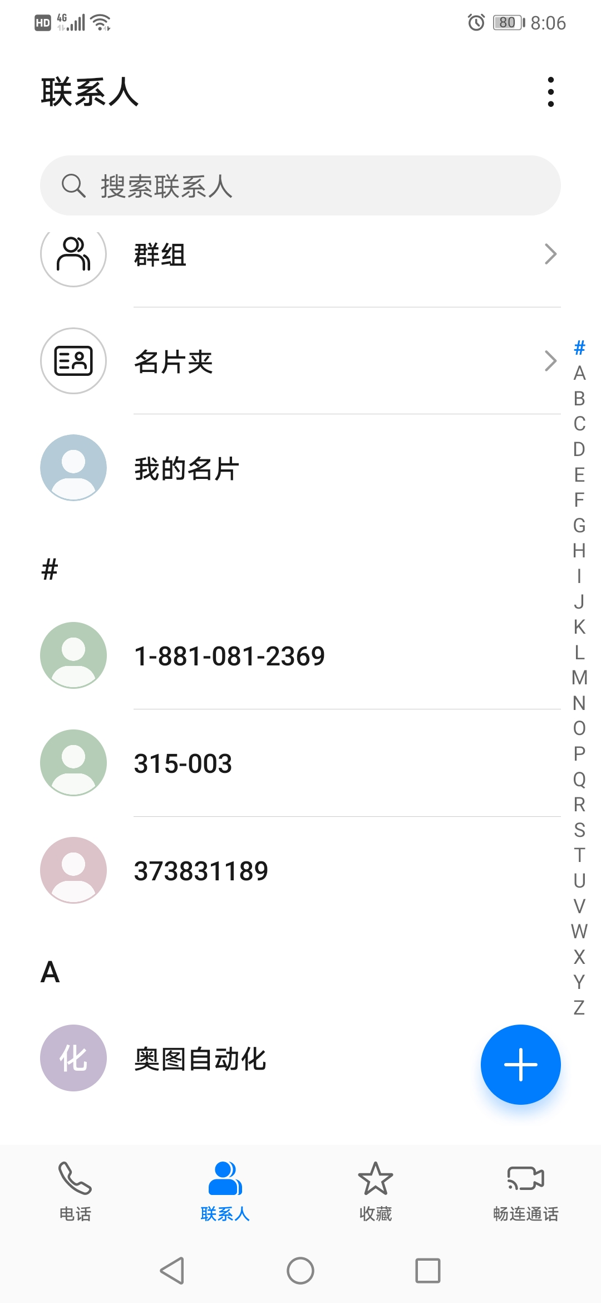
HomeWork 5: Address book
功能要求
增删改查，查询支持模糊查询
人员信息：姓名，电话号码，邮箱
录入信息有效性验证
界面要求
搜索功能和联系人列表在同一屏幕
其他方面不作具体要求，可参考各自喜欢的界面
提交时间：2020-11-30

